Slide 1
Myoelectric Hand Gesture Classification
Thien Nguyen

Slide 2
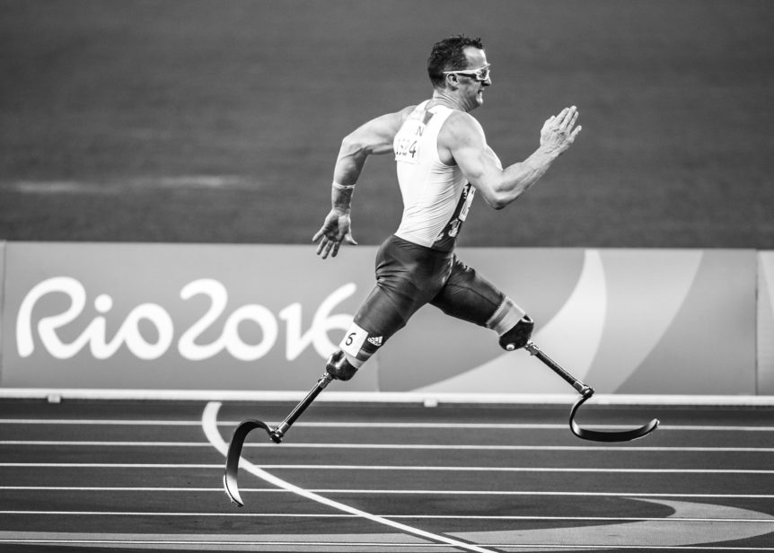
Background

Slide 3
Background

Slide 4
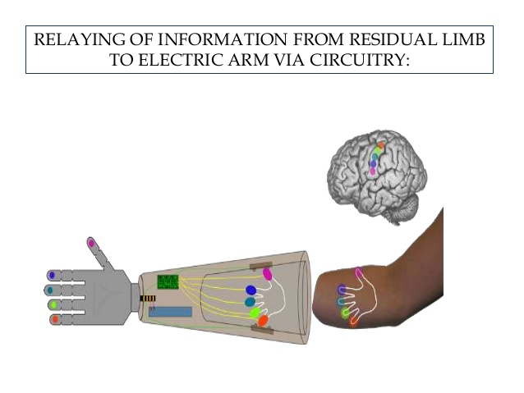
Background

Slide 5
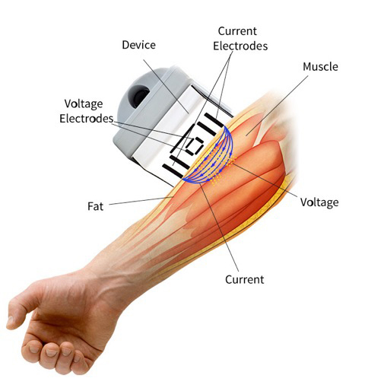
The Project

Slide 6
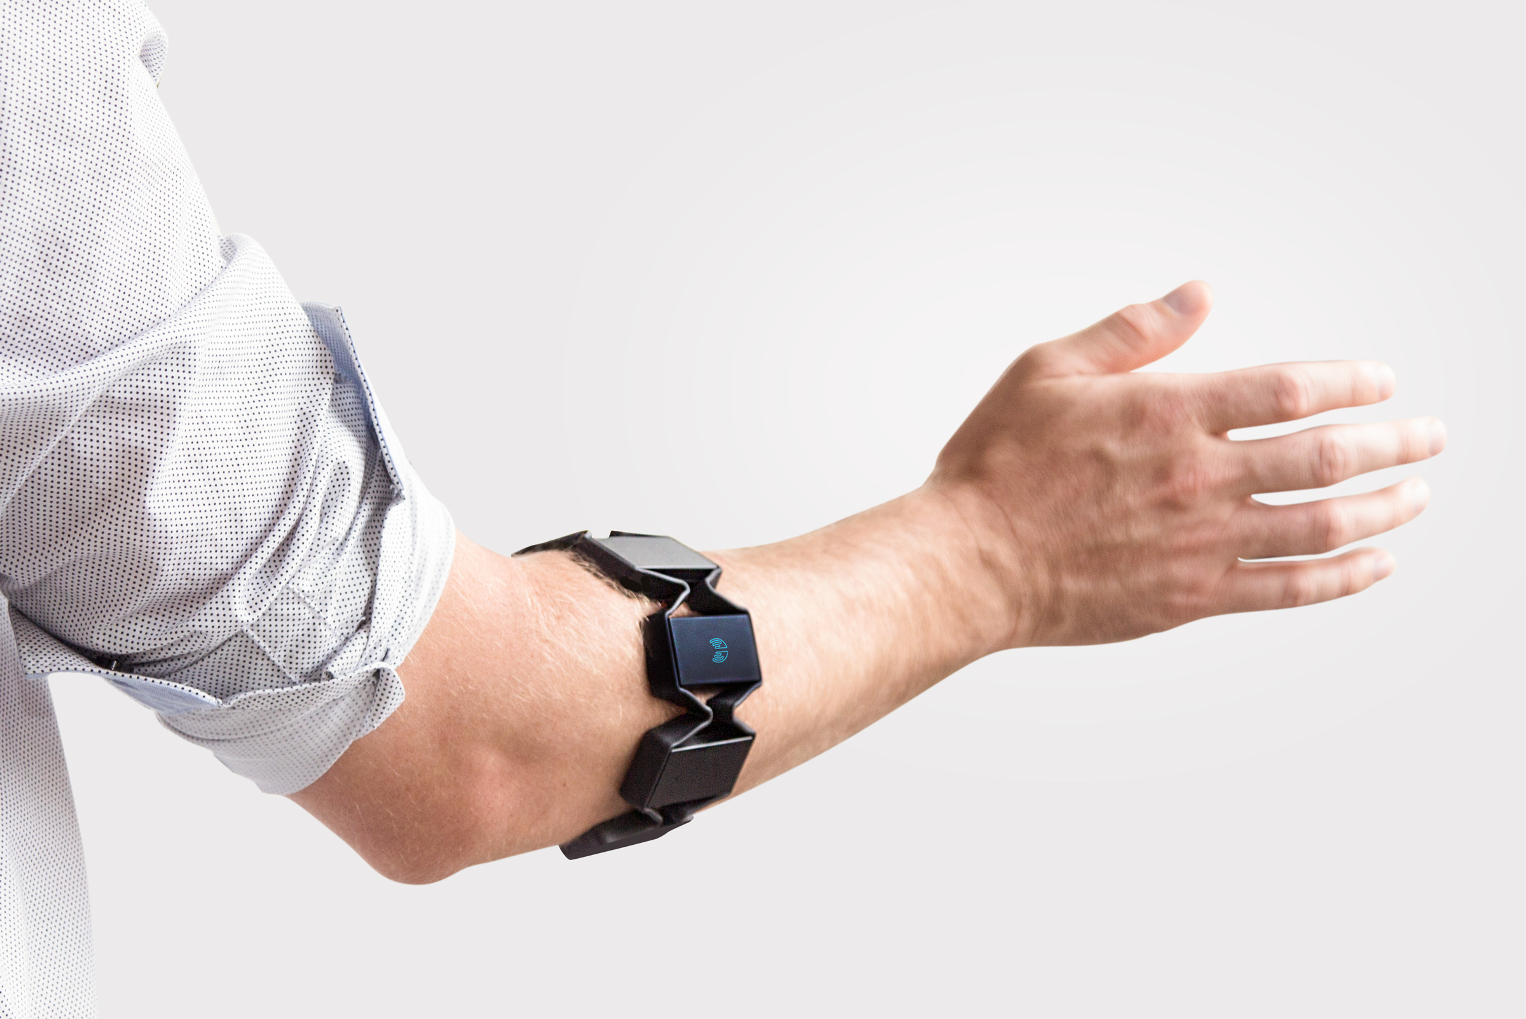
The Project

Slide 7
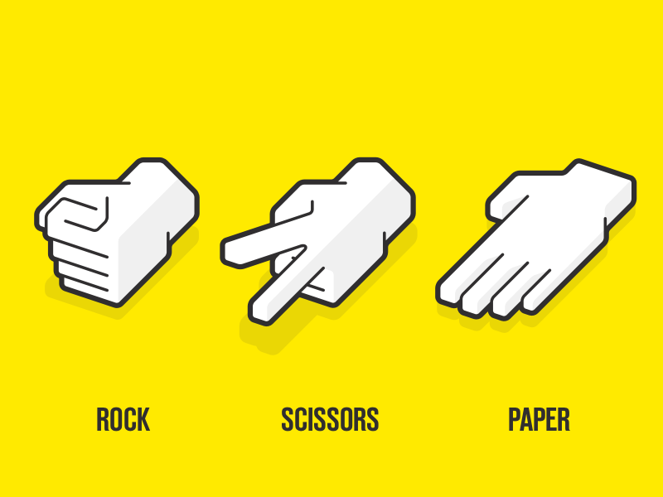

The Project- 4 Gestures

Slide 8
The Project - Preview
4 Target Gestures – rock, paper, scissors, ok
200 Hz sample rate
8 sensors with 8 readings
11674 rows of data with 64 features

Slide 9

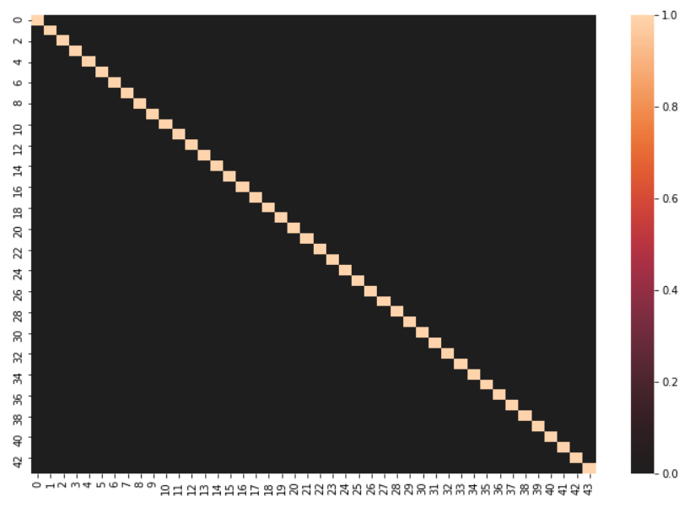
The Project- Exploration
No Null values
Reduced features to 44 items with PCA
No multicollinearity

Slide 10
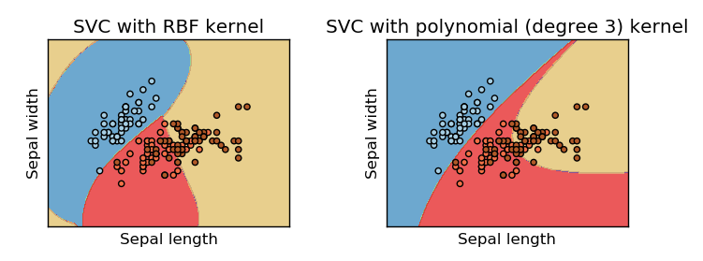
The Project-Modeling & Results
Best Accuracy Results
- SVM Default Parameters: 89.46%
-SVM Polynomial kernel with Bayes Optimization: 88.94%
Notes:
7. Five models with default parameters created with Pipeline and evaluated on accuracy
1. Naive_Bayes pipeline test accuracy: 55.50%
2. Tree pipeline test accuracy: 52.25%
3. Random_Forest pipeline test accuracy: 66.17%
4. SVM pipeline test accuracy: 89.46%
5. XGBoost pipeline test accuracy: 68.48%
8. Random Forest, SVM, and XGBoost classifier repeated in conjunction with Bayes Optimization and Grid Search for hyperparameter optimization
1. Random Forest
1. Grid Search Accuracy - 62.96%
2. Bayes Accuracy - 68.82%
2. XGBoost
1. Grid Search Accuracy - 85.18%
2. Bayes Accuracy - 85.26%
3. SVM
1. Grid Search Accuracy - 86.00%
2. Bayes Accuracy (rbf) - 89.40%
3. Bayes Accuracy (polynomial) - 88.94%

Slide 11
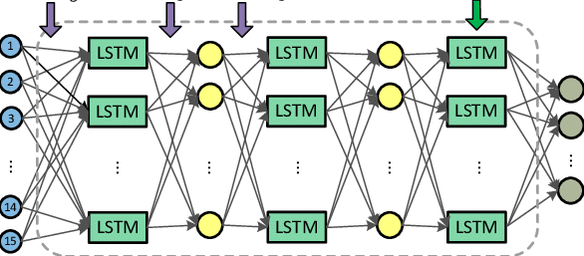
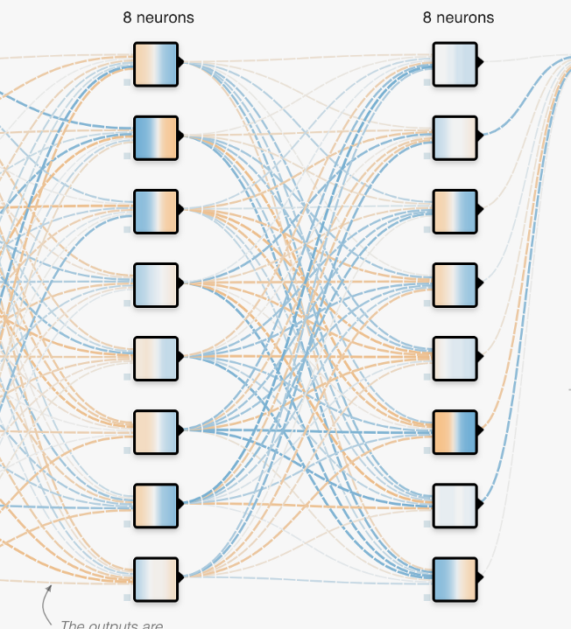
Further Considerations

Slide 12
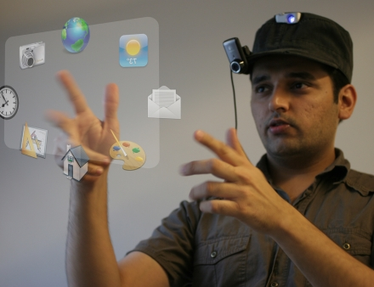
Future Applications

Slide 13

Future Applications

